Slide 1
Automated, distributed system testing of Kubernetes controllers
Lalith Suresh
Xudong Sun
VMware
University of Illinois at Urbana-Champaign

Slide 2
Controller
Central to extending Kubernetes
(databases, networking, storage….)

Slide 3
Controller
MyApp

Slide 4


API
Controller
MyApp
Desired State
Current State

Slide 5
API
Controller
MyApp
Controller is one component in a distributed system

Slide 6
API Server
Controller
MyApp
API Server
API Server

Slide 7
API Server
Controller
MyApp
API Server
API Server
Controller
Controller
Etcd

Slide 8
API Server
Controller
MyApp
API Server
API Server
Controller
Controller
Controller
Controller
Etcd
Controller

Slide 9
API Server
Controller
DB-Node-5
API Server
DB-Node-5
API Server
DB-Node-3
Controller
Controller
Controller
Controller
Etcd
Controller

Slide 10
Distributed System Pitfalls
API Server
Controller
DB-Node-5
API Server
DB-Node-5
API Server
DB-Node-3
Controller
Controller
Controller
Controller
Etcd
Controller

Slide 11

Slowness?
Missed
events?
API Server
Controller
DB-Node-5
API Server
DB-Node-5
API Server
DB-Node-3
Crashes?

Slide 12
Consequences ☹ Data loss, unavailability, resource leaks…
(accidentally deleting volumes, StatefulSets, inconsistencies…)

Slide 13
Testing correctness in the presence of such faults is hard
Bugs might require a very specific ordering of events

Slide 14

Sieve
https://github.com/sieve-project/sieve
Test at development time
Ease-of-use
No source
modifications
Reproducibility

Slide 15
Sieve
Overview
Demo
Internals
Rest of this Talk

Slide 16
Sieve
Overview
Demo
Internals
Rest of this Talk

Slide 17
What to test for?
Safety
(nothing bad happens)
Liveness
(eventually, something good happens)

Slide 18
Learning
Mode
When to restart controller? When to lag API server?
……..
Sieve
Controller
Need to trace an execution
and control timing

Slide 19
Sieve
Controlled environment with instrumented API Servers
Kind Cluster
Sieve
Controller
Test Workload
E.g., create app, delete app, create app again

Slide 20
Sieve
Sieve automatically instruments controller_runtime, client_go
Kind Cluster
Sieve
Controller
Test Workload

Slide 21
Sieve
Kind Cluster
Sieve
Controller
Test Workload

Slide 22

Sieve
Kind Cluster
Sieve
Controller
Suspected Timing Sequences
Suspected Timing Sequences
Suspected Timing Sequences
Suspected Event Sequence
Test Workload

Slide 23
Sieve
Kind Cluster
Sieve
Controller
Suspected Timing Sequences
Suspected Timing Sequences
Suspected Timing Sequences
Suspected Event Sequence
Test Workload
Trigger: StatefulSet X is created Fault: crash the controller
Trigger: pod Y is created Fault: delay API server

Slide 24
Sieve
Testing
Mode
Perturb the execution with injected faults
Kind Cluster
Sieve
Controller
Test Workload
Suspected Event Sequence

Slide 25
Sieve
Compare learning and testing runs
General-purpose and dev-supplied assertions for safety/liveness
Kind Cluster
Sieve
Controller
Test Workload
Suspected Event Sequence

Slide 26
Sieve
e.g., compare set of all resources (volumes, pods…) with/without faults
Kind Cluster
Sieve
Controller
Test Workload
Suspected Event Sequence

Slide 27
Sieve
Kind Cluster
Sieve
Bug
found!
Controller
Test Workload
Suspected Event Sequence

Slide 28
Sieve
Overview
Demo
Internals
Rest of this Talk

Slide 29
Sieve Demo
Use Sieve to test a Cassandra controller
and find a bug that causes resource leak

Slide 30
Example bug-pattern Observability-gaps Bug
Controller
S1
The controller maintains a local copy of cluster state

Slide 31
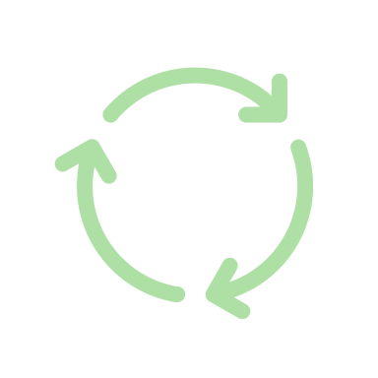
Example bug-pattern Observability-gaps Bug
Controller
event
S1
Reconciler
loop
The reconciler checks the cluster state and tries to achieve the desired state

Slide 32
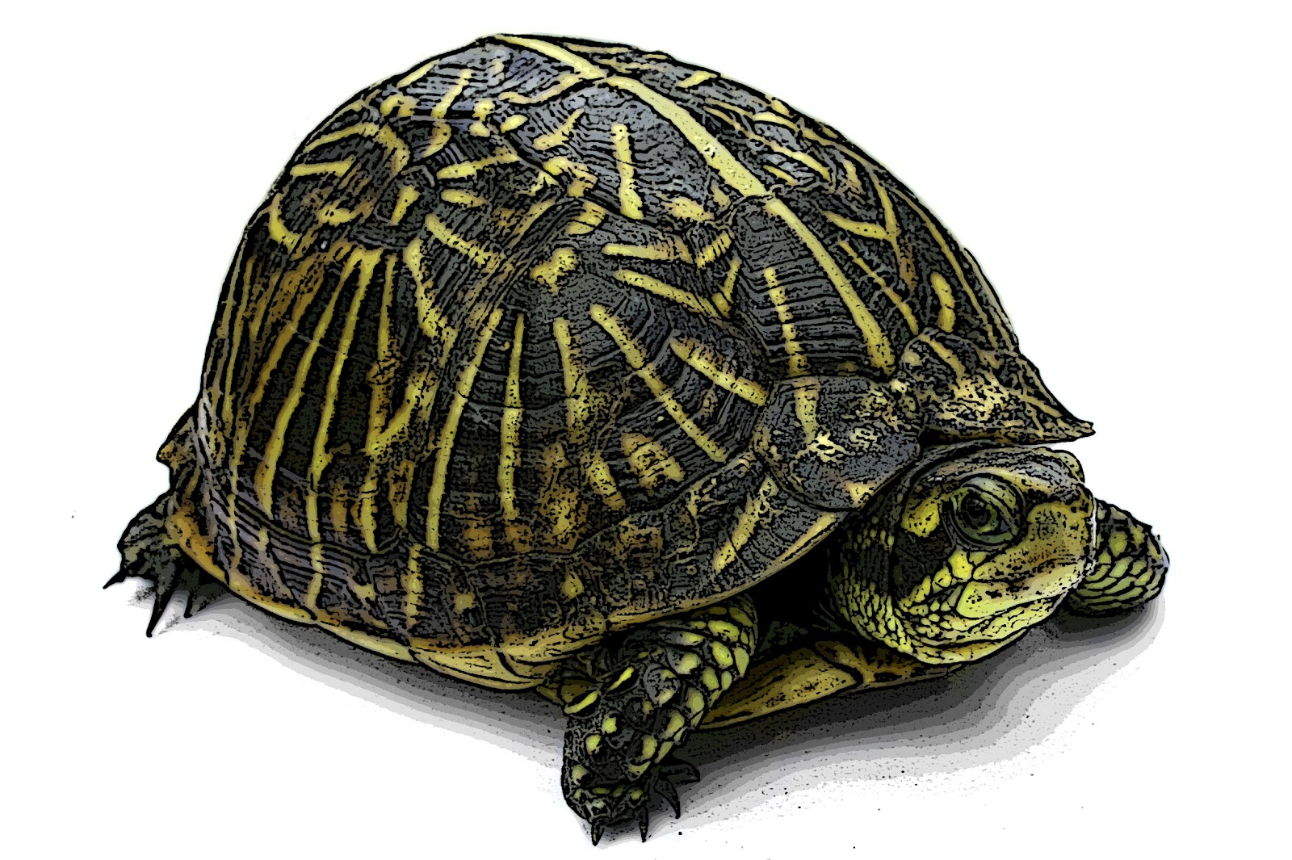
Example bug-pattern Observability-gaps Bug
Controller
Has not seen S2 yet
event
S2
Reconciler
loop
The reconciler might not
observe every state

Slide 33
Example bug-pattern Observability-gaps Bug
Controller
Has not seen S2 yet
S3
Reconciler
loop
The reconciler might not
observe every state

Slide 34
Example bug-pattern Observability-gaps Bug
Controller
Completely missed S2
Network issues,
node crashes,
etc.
S3
Reconciler
loop
The reconciler might not
observe every state

Slide 35
Example bug-pattern Observability-gaps Bug
Controller
Completely missed S2
S3
Reconciler
loop
The desired final state should be achieved even if the reconciler misses some intermediate states

Slide 36
Sieve
Sieve: Learning
Kind Cluster
Will the reconciler go wrong if state S is missed?
Sieve
Controller
Test Workload
Pick state S if it triggers a controller side effect

Slide 37
Sieve
Sieve: Learning
Kind Cluster
Sieve
Controller
Suspected Timing Sequences
Suspected Timing Sequences
Suspected Timing Sequences
Suspected Event Sequence
Test Workload
Trigger: state S
Fault: delay the reconciler

Slide 38
Sieve
Sieve: Testing
Kind Cluster
Sieve
Controller
Test Workload
Make the reconciler miss the state S by injecting delay
Suspected Event Sequence

Slide 39
Sieve
Sieve: Testing
Kind Cluster
Sieve
Bug
found!
Controller
Test Workload
Test assertions:
Compare resource status during learning run and testing run
Suspected Event Sequence

Slide 40
Debugging with Sieve
No finalizers
if cassandraPod.GetDeletionTimestamp() != nil {
existingPVCs := r.getPVCs(cassandraPod)
r.deletePersistenceVolumeClaim(existingPVCs)
}

Slide 41
Debugging with Sieve
When scaling down (2 -> 1):
Has not yet seen deletionTimestamp
Controller
update pod P
S2
S1
{
"deletionTimestamp":
"NON-NIL”
}
Reconciler
loop

Slide 42
Debugging with Sieve
When scaling down (2 -> 1):
Completely missed deletionTimestamp
Controller
delete pod P
S3
S2
S1
Reconciler
loop
The bug causes resource leak and prevents future scale-up
The bug has been confirmed and fixed

Slide 43
Bug Patterns
Observability gaps
Time travel
Atomicity violations
…

Slide 44
Sieve
Overview
Demo
Internals
Rest of this Talk

Slide 45
Sieve Architecture
API Server
Controller
Sieve
Test Driver
API Server
API
Server
Sieve Client
Sieve Client
Sieve
Analyzer
Sieve Server

Slide 46
Sieve Analyzer
Controller trace
[event] STS Creation
[event] POD Creation
[reconcile] start
[effect] SVC Update
[effect] PVC Update
[reconcile] end
......

Slide 47
Sieve Analyzer
Controller trace
[event] STS Creation
[event] POD Creation
[reconcile] start
[effect] SVC Update
[effect] PVC Update
[reconcile] end
......
Suspected Timing Sequences
Suspected Timing Sequences
Suspected Timing Sequences
Causality Pair
(event, effect)
Sieve infers that event may cause effect

Slide 48
Sieve Analyzer
Controller trace
[event] STS Creation
[event] POD Creation
[reconcile] start
[effect] SVC Update
[effect] PVC Update
[reconcile] end
......
Suspected Timing Sequences
Suspected Timing Sequences
Suspected Timing Sequences
Suspected Timing Sequences
Suspected Timing Sequences
Suspected Timing Sequences
Causality Pair
(event, effect)
Suspected Event Sequence

Slide 49
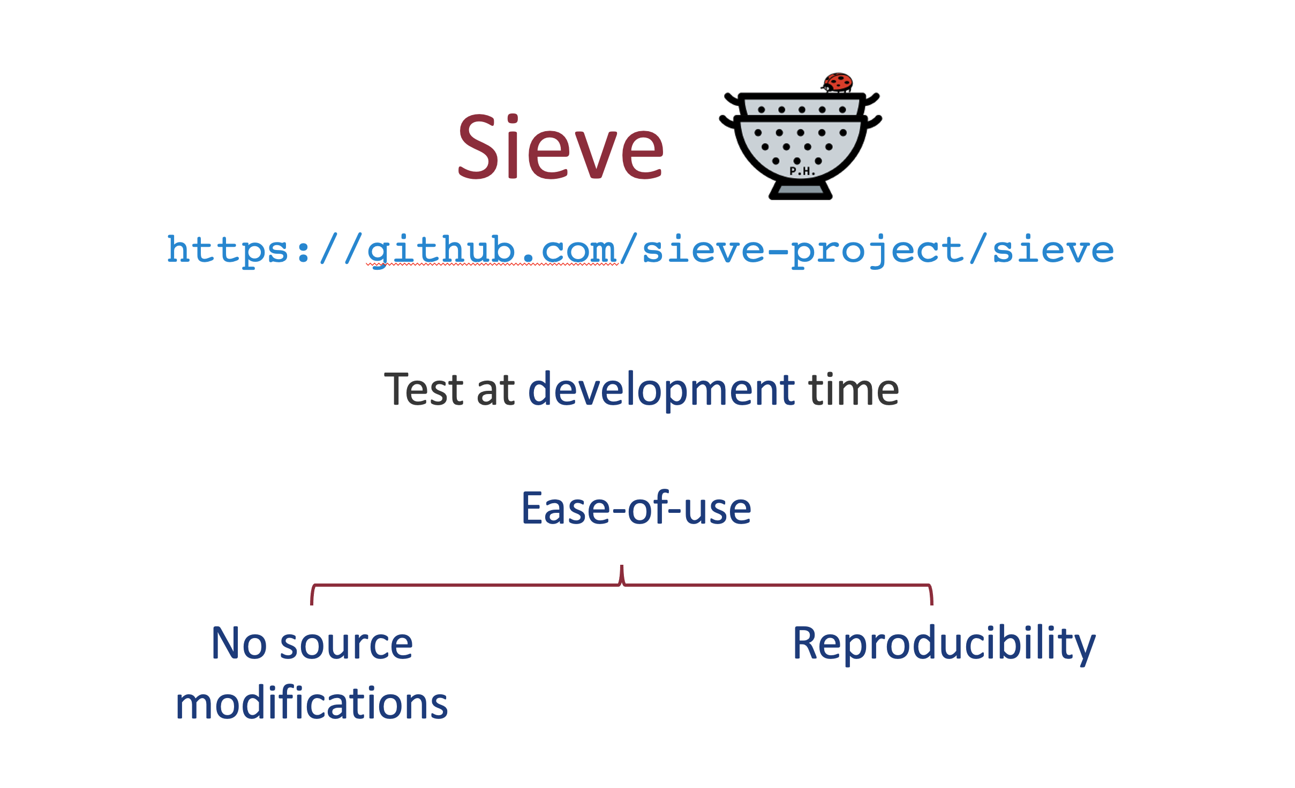
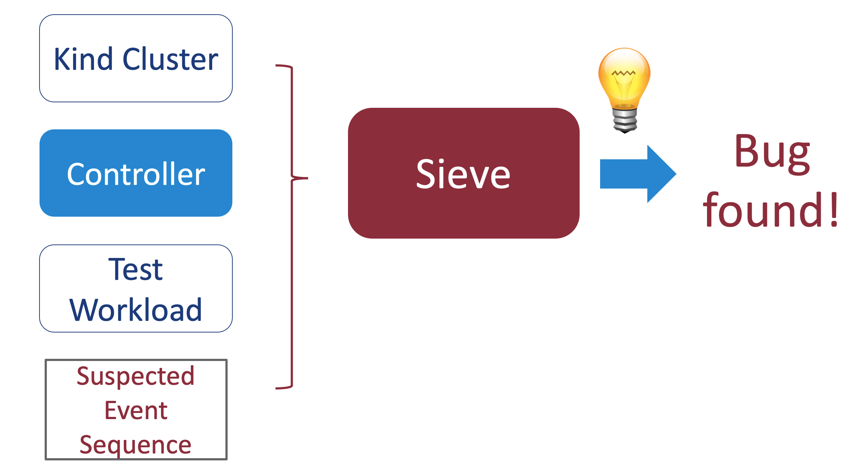
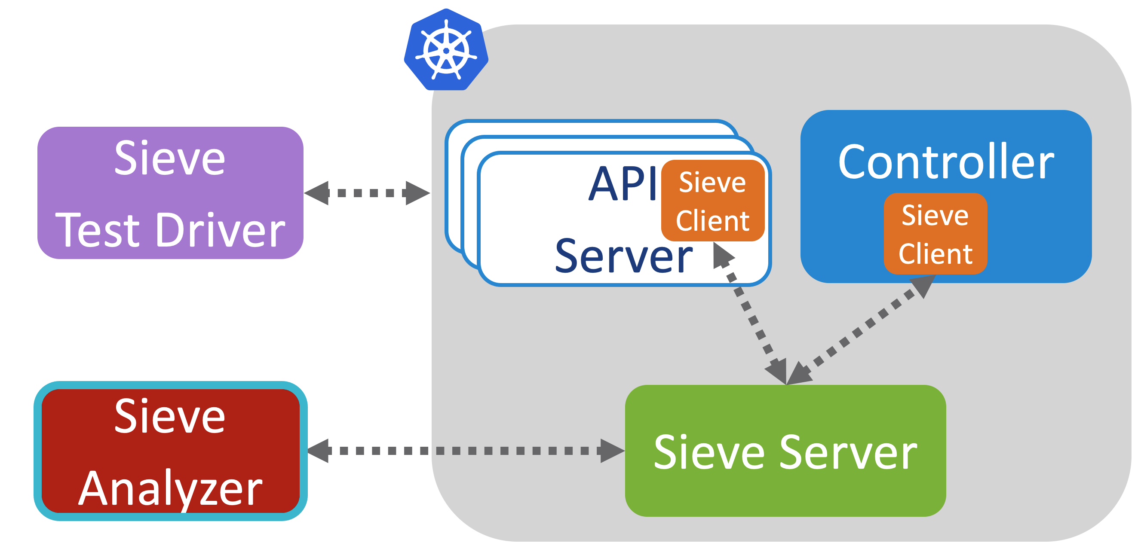
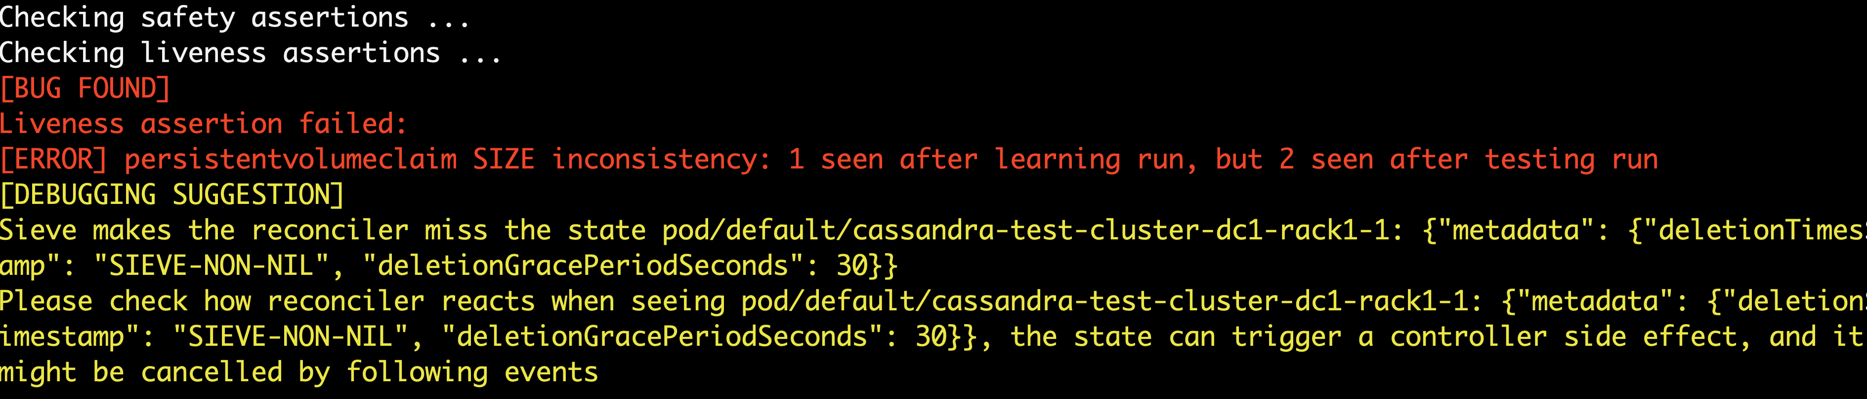
Conclusion

Slide 50
Thank you!
Any other bug patterns you would like to test for your controller?​
​
What would make you comfortable using such a tool?​
​
Let us know if you want to give Sieve a spin!
https://github.com/sieve-project/sieve

